Slide 1

Artificial Intelligence Project

Slide 2
Agenda
01 EDA & Data Processing
02 Forecasting Models
03 Neural Network
04 Conclusions

Slide 3


Dataset & Problem description
The Dataset
The Goal
Airbnb is used to expand on traveling possibilities and present a more unique, personalized way of experiencing the world. The listings generate data that can be analyzed and used for business decisions, understanding of customers’ and providers’ behavior on the platform, implementing innovative additional services and much more.
Our dataset is formed by information regarding the apartments listing in the New York City area. It is a mix between categorical and numeric values.
Information goes from the availability of the apartment to its characteristics. Moreover, we have information about the neighbourhood in which the apartment is located. Finally, we have data that regard the host.
The goal we want to achieve is to predict the future occupation of an apartment in NYC.
The prediction will be for the following year, and it will be based on the apartments’ characteristics and the price.
For this, we worked with a brand-new variable, ‘occupation_class’, that divides the apartments into 4 groups based on their occupation rate.
The study adopted a comparative approach by using four different methods—OLS, Decision Tree, random forest and Neural Network—and applied it to a vast amount of data from the Airbnb listing dataset of New York cities.
Assumption: we considered the population inside the dataset as representative of the reality.

Slide 4
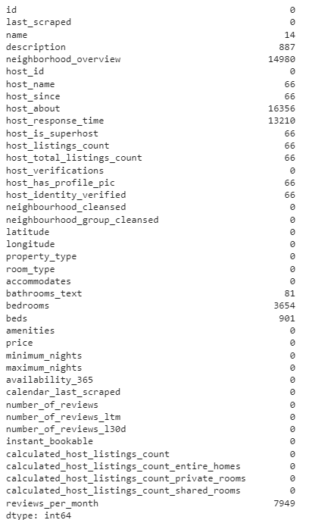


Our Dataset Presentation and description of our dataset and our goal for this project
01
STRUCTURE
Initially, the shape of our dataset was
(37410, 74)
We have numerous variables with null values that need to be cleaned.
For example, variables like reviews_per_month, host_about, host_response_time and neighborhood_overview are the ones with the highest numbers of NaN values.
NAN VALUES

Slide 5
Cleaning - EDA (1/2) We performed changes and in-depth analysis to obtain a final cleaned dataset
01
Variables selection
NaN Analysis and Dropping
Variables Conversion
One Hot Encoding
Initially, we started cleaning our dataset removing variables that were not significant for us. We analysed every variable in order to decide the potential magnitude of it, dropping the ones that were not useful. This analysis was done according to literature informations about general hosting rules and indications. Investigations improved during the implementation of models, when we observed different results according to the exclusion of some features.
We then used the functions created before to analyse NaN values and we proceeded with dropping them.
Furthermore, we converted variables that needed it in datetime and those that were numeric and float into categorical ones.
Moreover, we did the One Hot Encoding of the followings:
property_type
room_type
bathrooms_text
neighbourhood_cleansed

Slide 6
Cleaning - EDA (2/2) We performed changes and in-depth analysis to obtain a final cleaned dataset
01
New variables Creation
Scaling
We created new variables that we thought could be helpful for our analysis.
We scaled our data in order to perform Machine Learning models.
The final shape of our cleaned database was:
Variables created:
occupation_rate
redditivity_index
redditivity_yearly_max
occupation_class
(20553, 292)

Slide 7

Cleaning – Focus on Variables selection Some variables contained unuseful information, for this reason we went in depth and decided how to handle them
01
We removed all the variables containing URL link, as they did not give any kind of directly useful information as well as information not related to our goal.
We deleted some variables that could mislead the prediction. This selection was done after analysing their meaning according to reality.
Ex: ‘first_review’ could be an indicator of the longevity of the apartment, but it couldn’t give us useful information: an announcement can be in Airbnb platform since 2008, be open for 1 year and have some reviews but then been closed for 2 years and then re-open. The same kind of reasoning can be applied to ‘last_review’.
Dataset
Some variables had redundant information; thus we selected just the one that better summarized the meaning.
Ex: 'host_response_rate' summarized in 'host_response_time’ or 'minimum_minimum_nights' in 'minimum_nights', ecc.
There were information about host’s personal characteristics that were not useful to explain how it could affect the availability (host_location).

Slide 8




Cleaning – Focus on NaN values Due to the high number of variables with null values, we tried to handle them in different ways.
01
How did we decide to handle them
For our string variables, name, description, neighbourhood and host_about, we decided to use the NAtext function. With NAtext, we substitute the Nas with the empty string: “” .
Moreover, we found out that there were 7 variables which all contained exactly 66 NaN. So, we were curious about finding out whether there were all the same or not. In the case it was the latter, the idea was to drop all of them simultaneously. The 7 variables were: host_is_superhost, host_has_profile_pic, host_identity_verified, host_listings_count, host_total_listings_count, host_since, host_name.
The NAs were, indeed, the same, so we dropped all the null values.
Subsequently, we dropped the NaN related to bathrooms_text (81), bedrooms (3643), beds (890), the variables, since they were not that numerous.
Finally, we handled the variables reviews_per_month and host_response_time as they had a lot of missing values as well. In order to remove them we substitute everything with 0 and ‘Null’.
For the first column we decided to substitute with 0 as the NAs were almost 7000 and we did not want to lose important information.
While we decided to handle the second one as ‘Null’ since the variable was an object.

Slide 9

Cleaning – Focus on One Hot Encoding We performed changes and in-depth analysis to obtain a final cleaned dataset
01
One-hot encoding is a possibility that came in help when we needed to work better with messy data.
In fact, it transformed categorical data into numerical so that we can apply our Machine Learning algorithms without any problems.
Thanks to this, some initial variables in our dataset are no more present because we have transformed them using function as One Hot Encoding (e.g. ‘neighbourhood_group_cleansed’) or we have rewritten them in a simpler way to group features with same meaning but different writing type (e.g ‘bathroom_text’).
We performed One-Hot Enconding on the following variables:
neighbourhood_group_cleansed
room_type
Host_verifications
bathrooms_text
Host_verifications:
We created a list that include the different type of host verification ('email', 'phone', 'work_email') and we created a dataset which columns correspond to elements of this list: for each row, 1 correspond to the presence of this host verification, 0 otherwise. Then we merged with the initial dataframe.

Slide 10



Cleaning – Focus on One Hot Encoding We applied the functions to obtain a final cleaned dataset
01
Bathroom_text:
We firstly observed that there were several different types of bathrooms. For example, ‘1.5 baths’, '1 shared bath', '1 private bath’, 'Shared half-bath', '2 baths', 'Half-bath’ up until ‘8 Baths’. But, even if the number could differ, there were only 3 different categories. So, we summarised everything into 3 main classes:
Bath / private bath
half_bath
shared _bath
Neighbourhood_group_cleansed:
OHE that indicated the presence of the listing in one of this New york’s cities: 'Staten Island', 'Manhattan', 'Bronx', 'Brooklyn', 'Queens'.
Room_type:
OHE that indicated the type of accommodation of the listing: 'Entire home/apt', 'Private room', 'Hotel room', 'Shared room'

Slide 11

Cleaning – Creation of 'occupation class' We defined our variable of interest
01
The goal of our analysis was to predict the occupation of an apartment for a whole year, giving the specific features that a specific structure had.
We needed to create a variable that indicate the number of days that were occupied during the year.
We started analyzing the variable 'availability_365'. First, we observe the presence of 12386 apartments that were not available to be booked: we decided to not consider them, in order to create a variable that only consider open structure.
Then we defined a ‘occupation rate’, as the difference between total days of the year and days availability, divided by 365.
We also defined a 'redditivity_index' that explains potential revenues of a structure, obtained multiplying the price by the available days.
Finally we created the ‘occupation class’ variable, that indicates four different range of occupation per structure:
Class | Range
0 | 0% - 25%
1 | 25% - 50%
2 | 50% - 75%
3 | 75% - 100%

Slide 12
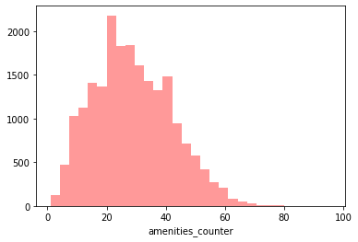
Cleaning – Focus on Amenities We dedicated part of our analysis to the amenities variable
01
Amenities are everything that helps to provide comfort, convenience, or enjoyment.
For a listing apartment, providing the highest and most useful instruments means having a better image and probably receive more attention from the customers.
Thanks to its importance, we tried to work on this variable.
The column presented a complete list of amenities for each apartment listed.
It went from having a Carbon monoxide alarm and Shampoo to offering a Hair dryer or the Heating as well as Wi-fi and a Bathtub. However, the column alone was not providing statistical significance as it was only a vector of strings.
Initially each individual amenity mentioned in the listing in the textual format was used as an independent variable.
Then we understood that it was too specific, especially when performing classification, thus we created a counter.
In fact, we decided to give credit and importance more to the quantity rather than the quality.
Here on the left we can see that there are a lot of apartments with more than 20 amenities.
The majority is between 20 and 40, with some of them that arrive to almost 80.

Slide 13
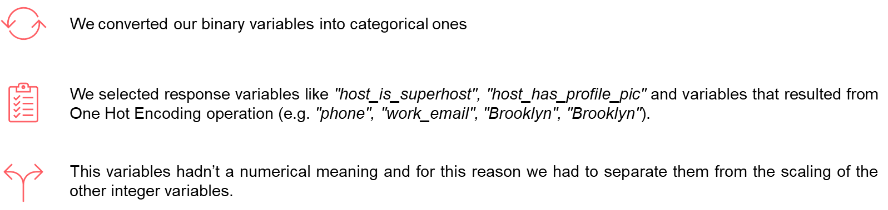
Cleaning – Scaling Convert and scale variables
01
To avoid Machine Learning algorithm assumptions like higher ranging numbers have superiority of some sort, feature scaling is needed to bring every feature in the same footing without any upfront importance.
Moreover, feature scaling reduces the time the learning algorithm converges to the end result and improves the effectiveness of the statistical model.
We imported ‘MinMaxScaler’ from sklearn.preprocessing.
This estimator scales and translates each feature individually such that it is in the given range on the training set, e.g. between zero and one.
This Scaler responds well if the standard deviation is small and when a distribution is not Gaussian. This Scaler is sensitive to outliers.

Slide 14
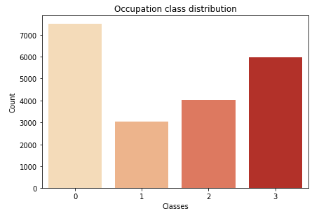
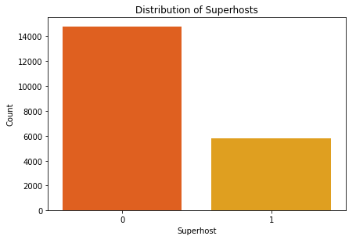
Data Visualisation (1/4) Once cleaned, we plotted our variables in order to search and find possible correlations
01
1 Univariate Analysis
Data visualization is the discipline of trying to understand data by placing it in a visual context so that patterns, trends, and correlations that might not otherwise be detected can be exposed.
Here, we show part of the variables that were interesting for us and that we plotted in order to see their distribution.
The first one is the distribution of the ‘occupation_class’.
As we can see from the graph, the most present value is when occupation is equal to 0.
This means that we have more apartments with an occupation rate between 0 and 25%, while the second most present is the last one, when the variable is equal to 3.
Listings that are occupied between 25% and 50% are the least present in our dataset.
The second graph show how many super-hosts we have in the dataset.
Super-host is when the owner of the apartment that is listing it answers to a list of KPIs that make him/her a better and more secure individual.
As we can see, we have less super-hosts with respect to just hosts.
5771

Slide 15
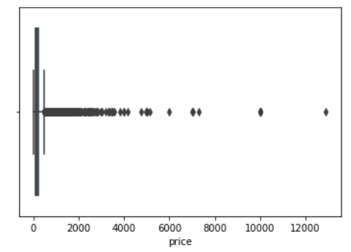
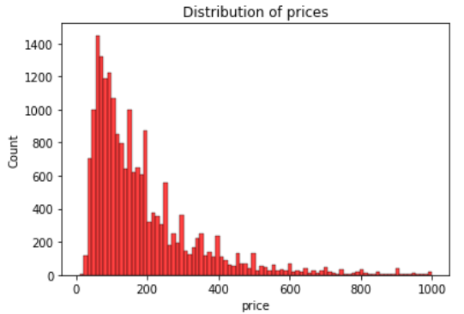
Data Visualisation (1 bis/4) Once cleaned, we plotted our variables in order to search and find possible correlations
01
1 Univariate Analysis
The third and fourth graph show the distribution of prices for the whole set of structures chosen.
We can clearly see that the upper and lower extremes of the boxplot are defined by low prices, while on the right we observe a wide range of outliers.
For this reason we restrict the visualization on the interval (0, 1000), being able to better visualize the real distribution.
There are a lot of outliers here

Slide 16
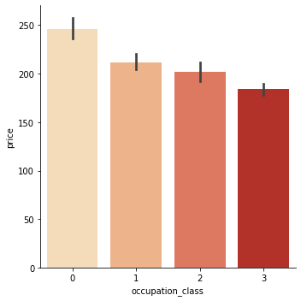
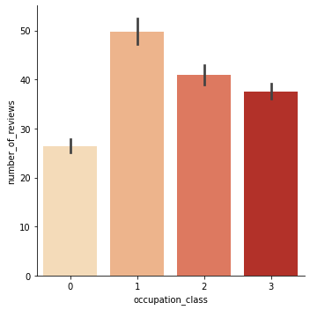
Data Visualisation (2/4) Once cleaned, we plotted our variables in order to search and find possible correlations
01
2 Bivariate Analysis
The first graph on top we can see the distribution of the ‘occupation_class’ regarding the number of reviews.
As we can see from the graph, the class that has the highest number of reviews is the second one (occupation_class = 1), followed by the higher classes.
While the class where all the apartments occupied between 0% and 25% is at the bottom.
The second graph show the relationship between the ‘occupation_class’ and ‘price’.
Here, the situation changes in favor of the apartments with the lowest rate of occupation.
In fact, they are the ones with the highest prices overall, while the category with more that 75% of bookings have the lowest prices.

Slide 17
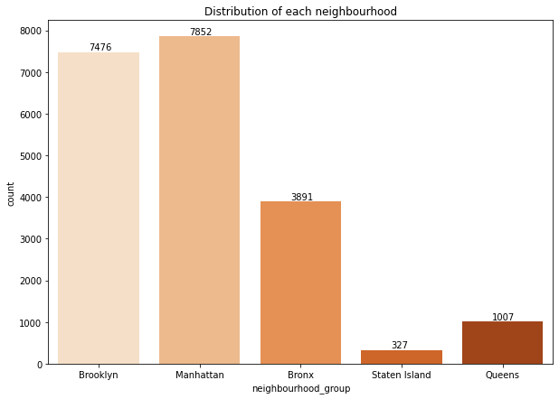
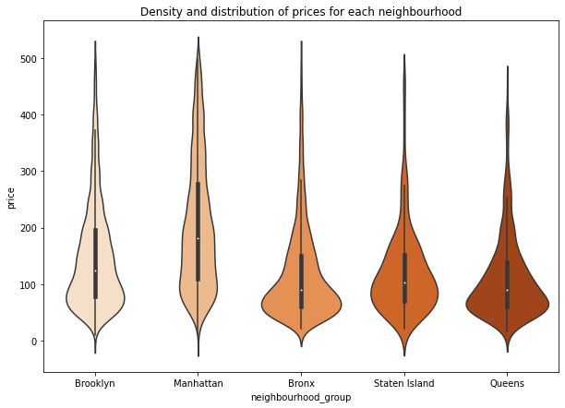
Data Visualisation (3/4) - Neighbourhoods Geographical position has been extremely important for us as we are dealing with New York apartments.
01
During our data visualisation, we focused our attention also on the neighbourhoods of the city.
The graph above shows that most of the apartments listed are in the Manhattan (7852) and in Brooklyn (7476) neighbourhoods with Staten Island being the one with the lowest number overall (327).
From the violin graph on the left, we can see how the prices are distributed around the neighbourhood.
As one could expect, the highest prices are in Manhattan with $150 price as average observation while more residential neighbourhoods like Queens and Staten Island tend to have a larger price base between 0 and 200 and a very similar distribution. Bronx is the cheapest of them all, as it appears to have lower standards of living.

Slide 18





Mapping processing Rent a place in New York City means having a lot of places of interest around. This could mean different prices.
01
We have found that the variables ‘longitude’ and ‘latitude’ were highly significant.
For this reason, we tried to see whether particular tourists attractions or general places of interests in the Big Apple could be significant for the occupation too.
Places of interests and their coordinates:
Statue of liberty: 40.689249, -74.044500
Times Square: 40.758896, -73.985130
Empire State Building: 40.748817, -73.985428
Rockefeller Centre: 40.758678, -73.978798
We performed 3 different nested functions.
The goal was to see the distances between the places of interests and the apartments.

Slide 19
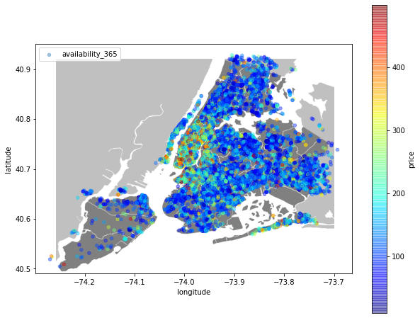
Mapping processing Rent a place in New York City means having a lot of places of interest around. This could mean different prices.
01
Availability of New York apartments based on prices
On the south we have Staten Island. On the part of land on the right we have Brooklyn on the south east and Queens on the north.
Finally, on the part of land on the north, we have both Manhattan on the south and Bronx on the north.
This is again a proof that apartments listed in Manhattan are the most expensive while the majority part of Brooklyn, Bronx and Queens have the cheapest price.
Using latitude and longitude points we were able to represent all NYC listings around all the five districts.
We observe a very immersive heatmap.
Also, we added a color-coded range for each point on the map based on the price of the listing. However, it is important to note that we had to drop some extremely high values as they are treated as outliers for our analysis.

Slide 20
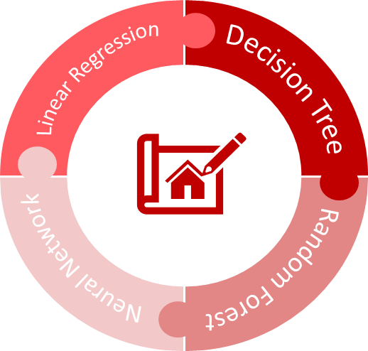
Forecasting Models – General Overview Once cleaned, these are the models that we decided to use
02
a) We decided to proceed with 4 different models:
1. LINEAR REGRESSION
2. DECISION TREE
4. NEURAL NETWORKS
3. RANDOM FOREST
b) We did a division of the dataset into 60/20/20:
60% of the data has been given to the train set
20% of the data has been given to the validation set
20% of the data has been given to the test set
c) We then selected all the variables that were integer, float and categorical as the linear model does not work with qualitative data.
d) Furthermore, we will use 2 different datasets. We will initially use the entire one, and only after we selected a few important variables and tested the models with that.
In order to decide the best model overall, for every model we will look for Accuracy

Slide 21


02
Forecasting Models – Linear Regression (1/2) We proceeded with the forecasting models. The first one chosen has been the linear regression. )
How did we proceed?
Regression analysis is one of the most important fields in statistics and machine learning. Between the many regression methods available, we started our analysis with the Linear regression. In fact, we used this model as an initial starting point.
Regression searches for relationships among variables. You need regression to answer whether and how some phenomenon influences the other or how several variables are related.
Regression is also useful when you want to forecast a response using a set of predictors.
Advantages:
Disadvantages:
It is a simple model that studies the relationship between the multiple predictor variables and predicted variable.
The modeling speed is fast, so it does not require complicated calculations.
Ability to determine the relative influence of one or more predictor variables to the predicted value when the predictors are independent of each other.
It is too simplistic to capture real world complexity.
It makes strong assumptions that there is Predictor and Predicted variables are linearly related which may not be the case.
Outliers can have a large effect on the output.
It assumes that the predictor variables are not correlated which is rarely true.
It assumes constant variance around the mean which is unrealistic in most cases.

Slide 22
02
Forecasting Models – Linear Regression (2/2) We proceeded with the forecasting models. The first one chosen has been the linear regression.
Why we did it
We tried to proceed with the Linear Regression in order to avoid overfitting.
What we did
Our dependent variable is ‘occupation_class’ while, the regressors are variables correlated with hosts and apartments characteristics.
We import the ‘train_test_split’ and ‘LinearRegression’ from sklearn
We split the dataset into train and test set with the size of the test equal to 20% of the entire dataset
We wanted the linear model to be a basis level of prediction. Unfortunately, as our mission is to detect the occupation class (4 classes), we had to change our response variable Y using ‘occupation_rate’. This value is a generic percentage in a range of 0-100%, which is highly correlated with the occupation class since they have a linear relationship.
Results
Looking on the values we that our results are not that good at predicting.
In fact, it ends up overfitting the model so for this reason, we moved on to the Decision Tree.
Train Error | 0.098
Validation Error | 0.096
Test Error | 0.095

Slide 23
02
Forecasting Models – Decision Tree (1/3) We proceeded with the forecasting models. The second one chosen has been the Decision Tree
The second model that we decided to use was the Decision Trees (DTs).
Decision Trees are a non-parametric supervised learning method used for classification and regression.
The goal is to create a model that predicts the value of a target variable by learning simple decision rules inferred from the data features.
They are easy to interpret since they can be visualized and are capable of handling multi-output problems.
Advantages:
Disadvantages:
It can easily capture Non-linear patterns.
It requires fewer data preprocessing from the user, for example, there is no need to normalize columns.
It can be used for feature engineering such as predicting missing values, suitable for variable selection.
The decision tree has no assumptions about distribution because of the non-parametric nature of the algorithm.
Sensitive to noisy data. It can overfit noisy data.
The small variation(or variance) in data can result in the different decision tree. This can be reduced by bagging and boosting algorithms.
Decision trees are biased with imbalance dataset, so it is recommended that balance out the dataset before creating the decision tree.

Slide 24
02
Forecasting Models – Decision Tree (2/3) We proceeded with the forecasting models. The second one chosen has been the Decision Tree
Why we did it
We tried to proceed with the Decision Tree in order to avoid overfitting.
Also, having non-linear patterns, we used Decision Trees to try to find the correct classification model.
What we did
We tuned the max number of final leaves, detecting the best performance and from the output we select the tree with the best value of accuracy: the one with 26 leaves
Step 1
# of leaves | Train Accuracy | Validation Accuracy | Test Accuracy
2 | 0.387 | 0.380 | 0.392
10 | 0.460 | 0.448 | 0.462
26 | 0.486 | 0.475 | 0.482
29 | 0.487 | 0.477 | 0.481
From the table we can see that we got a good level of accuracy both in the train and in the validation set.
However, the accuracy level in the test is one of the worst overall.
For this reason, we moved on to the Random Forest.
Train Accuracy | 0.9999
Validation Accuracy | 0.9087
Test Accuracy | 0.4326

Slide 25
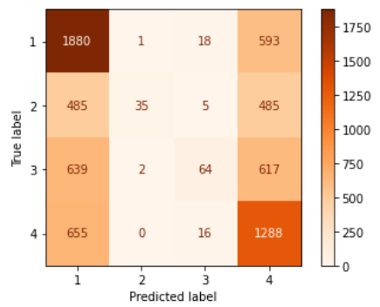
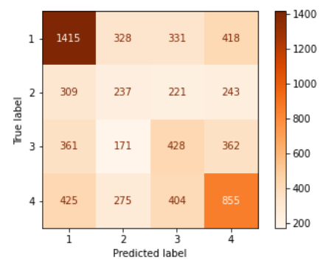
02
Forecasting Models – Decision Tree (3/3) We proceeded with the forecasting models. The second one chosen has been the Decision Tree
What we did
Step 1
We also created a confusion matrix for Decision Tree classifier, to better visualize the results of the classification:
But analysing the results with 26 different leaves, there were not big improvements in accuracy, therefore we tried to focus on full grown trees.
Step 2
We set maximum depth in a range between 20 and 30.
Again, we visualized results in a confusion matrix:

Slide 26
02
Forecasting Models – Random Forest (1/2) We proceeded with the forecasting models. The third one chosen has been the Random Forest.
For our third forecasting supervised model, we performed a Random Forest.
We thought about it as the reason that the random forest model works so well is that a large number of relatively uncorrelated models (trees) operating as a committee will outperform any of the individual constituent models.
In fact, we have low correlation between models, and this is the key to perform Random Forest at its best.
Advantages:
Disadvantages:
Highly accurate and robust method because of the number of decision trees participating in the process.
It does not suffer from the overfitting problem. The main reason is that it takes the average of all the predictions, which cancels out the biases.
The algorithm can be used in both classification and regression problems.
Can handle missing values.
You can get the relative feature importance, which helps in selecting the most contributing features for the classifier.
Slow in generating predictions because it has multiple decision trees. The whole process is time-consuming.
The model is difficult to interpret compared to a decision tree, where you can easily decide by following the path in the tree.

Slide 27
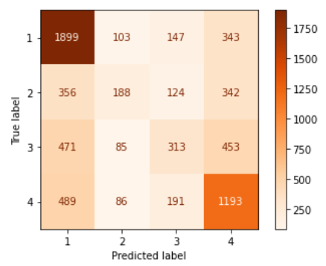
02
Forecasting Models – Random Forest (2/2) We proceeded with the forecasting models. The third one chosen has been the Random Forest.
Why we did it
We moved to the creation of a Random Forest since the Decision Tree was overfitting.
So,we tried to find a different solution that could help us avoid the situation again.
What we did
Our dependent variable is ‘occupation_class’ while, the regressors are variables correlated with hosts and apartments characteristics.
We imported ‘RandomForestClassifier’ from sklearn.ensemble
We imported ‘accuracy_score’ from sklearn.metrics
We started calculating trees with a range between 10 and 40, detecting the best performance.
From the output we selected the tree with the best value of accuracy.
In our case, the best was the one with 38 trees.
Results
Looking on the values we that our results are not that good at predicting.
In fact, it ends up overfitting the model, which was what we wanted to avoid in the first place.
For this reason, we tried also to compute the Neural Networks.
Train Accuracy | 0.9996
Validation Accuracy | 0.9165
Test Accuracy | 0.5297

Slide 28
03
Neural Network (1/4) We proceeded with Neural Network.
Finally, we decided to try a Neural Network.
Artificial neural networks are forecasting methods that are based on simple mathematical models of the brain. They allow complex nonlinear relationships between the response variable and its predictors.
The deep neural networks model (DNN model) can group unlabelled data based on similarities existing in the inputs or classify data when they have a labelled dataset to train on.
Using these, we can build very robust and accurate predictive models for predictive analytics.
Advantages:
Disadvantages:
Storing information on the entire network
Ability to work with incomplete knowledge
Having fault tolerance
Having a distributed memory
Gradual corruption
Ability to make machine learning
Parallel processing capability
Hardware dependence
Unexplained behaviour of the network: This is the most important problem of ANN. When ANN produces a probing solution, it does not give a clue as to why and how.
Determination of proper network structure: There is no specific rule for determining the structure of artificial neural networks.
Difficulty of showing the problem to the network: Problems have to be translated into numerical values before being introduced to ANN.
The duration of the network is unknown.

Slide 29
03
Neural Network (2/4) We proceeded with the forecasting models. The third one chosen has been the Neural Network.
Why we did it
We moved to the creation of a Neural Network since the Random forest was again a model that was overfitting.
So, we tried to find a different solution that could help us avoid the situation again.
What we did
Our dependent variable is ‘occupation_class’ while, the regressors are variables correlated with hosts and apartments characteristics.
We imported ‘train_test_split’ from sklearn.model_selection
We imported model and layers form keras
We created a sequential model, that allowed us to specify a sequential neural network: from input to output, passing through a series of neural layers, one after the other.
We created 3 different neural networks with a common pattern: halving the dimensionality of the neurons.
GOAL: Experiment with these parameters and evaluate which is the most performing architecture.
First network ⇨ the biggest, where the number of neurons started from 4000 and finished with 25.
Second network ⇨ the smallest, where the number of neurons started from 100 and finished with 10.
Third network ⇨ the intermediate, where the number of neurons started from 2000 and finished with 10.

Slide 30
03
Neural Network (3/4)
We proceeded with the forecasting models.
What we did
Step 1
First layer = Input layer ⇨ we specified the input shape.
shape equal to the number of features, corresponding to the number of columns in our dataset
We selected the ‘relu’ activation function, that transforms the output of one layer towards the next.
Step 2
We used input representation in terms of weights and bias to move from one layer to another.
Step 3
Output layer = the number of units in the final layer was equal to 4, corresponding to the classes in the variable 'occupation_class’ ⇨ In this case we must use the ‘softmax’ activation function.
Softmax maps the representation of the neural network to the classes in our dataset, assigning a probability to the prediction of each class.
Step 4
We then compiled the complete sequential model ⇨ we set a loss function, an optimizer and performance evaluation metrics.
Loss function ⇨ cross-entropy categorial
Optimizer ⇨ 'rmsprop’
Evaluation metric ⇨ accuracy

Slide 31
03
Neural Network (4/4)
Results
What we did
Step 5
We trained our sequential model:
↳ we have passed X and y, where X is our feature set and y is our target variable.
Results
We visualized the different performance of three models.
The most performing architecture was the biggest model, although the difference with the others is not so significant.
Again, these models were not so good at predicting.
 | BIG neural network | SMALL neural network | MEDIUM neural network
Train Accuracy | 0.5015 | 0.4636 | 0.5095
Validation Accuracy | 0.4649 | 0.4636 | 0.4837
Test Accuracy | 0.4649 | 0.4636 | 0.4837

Slide 32

Feature Selection We updated the dataset keeping only a selected number of important features
03
In case of Machine Learning we can use feature selection to help our AI interpret better values.
Feature selection is the process of reducing the number of input variables when developing a predictive model.
It is desirable to reduce the number of input variables to both reduce the computational cost of modeling and, in some cases, to improve the performance of the model.
1
We detected which variables were the most important, creating a reduced dataframe, with only relevant X's.
What is our goal?
2
We removed "occupation_class", that was our target variable, and "occupation_rate", as it was directly connected to it, and it could distort the result.
We performed a feature selection in order to see if we could have an improvement in accuracy results.
3
From sklearn.ensemble we imported RandomForestRegressor.
Using Random forest algorithm, the feature importance can be measured as the average impurity decrease computed from all decision trees in the forest.

Slide 33
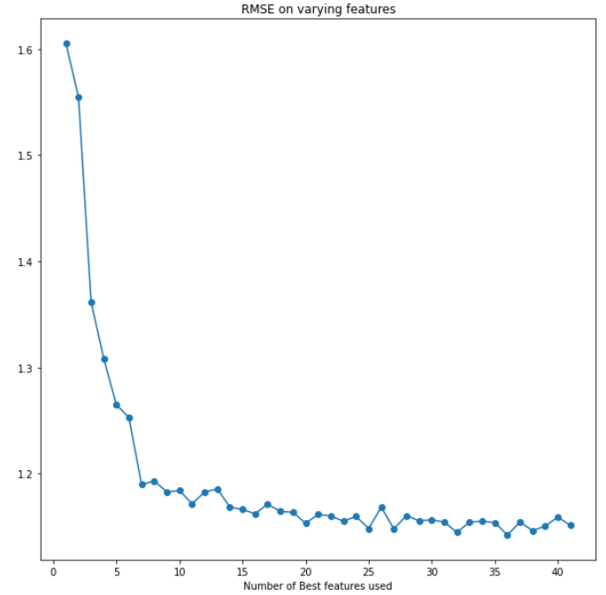
Feature Selection We updated the dataset keeping only a selected number of important features
03
What we did
The graph about RMSE on varying features suggested us to select a range between 5 and 10 features.
We selected 10 features, corresponding to :
‘host_since',
'price',
'thirdPointDistance',
'firstPointDistance',
'amenities_counter',
'maximum_nights',
'calculated_host_listings_count',
'reviews_per_month',
'calculated_host_listings_count_private_rooms',
'number_of_reviews'

Slide 34
03
Neural Network with different dataset
Results with reduced dataset
Results
After performing feature selection, we created two more neural networks that consider this new dataset.
 | BIG reduced neural network | SMALL reduced neural network
Train Accuracy | 0.4708 | 0.4479
Validation Accuracy | 0.4728 | 0.4552
Test Accuracy | 0.4728 | 0.4552
The results did not improve dramatically.
However, for the aim of the project removing so many variables leads to a distortion of the results.
Furthermore, the quite subjective choice of the number of features to select has a subsequent impact on the accuracy.

Slide 35
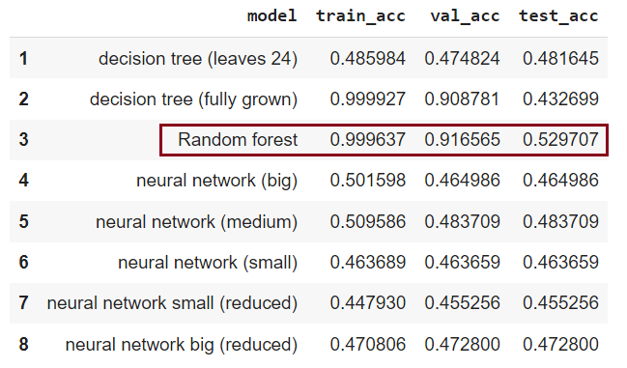

04
Conclusions (1/2)
We obtained these conclusions after having analysed and compared our different results
Table that compares the accuracy among all our models
RESULTS
The Random Forest is the best model overall
We noticed that overall results were weak.
The models don’t have good results, but an explanation is inherent in the type of study we are doing.
Analysing the results, we decided to consider as the best model the one with the greatest accuracy on the test set.

Slide 36

04
Conclusions (2/2)
We obtained these conclusions after having analysed and compared our different results
Models tries to recognize and create a pattern that allows us to understand, given the characteristics of a structure, the occupancy rate of an apartment listed in the NYC zone.
The availability of a property depends on bookings but also on the host’s final choices.
This subjectivity component significantly affects the results of the model.
In fact, we must consider that the owner of a property can make his apartment unavailable for personal reasons, but this will inevitably affect the actual prediction that we’re trying to get.
E.g. the flat is booked 200 days a year, but only 100 of these are actually occupied by guests, the others will be kept unavailable to the public for personal reasons: so, only the former will actually be indicative of how the characteristics of that place allowed a certain occupancy rate.
Although there are many variables available, the impact of host selection is overall highly significant and makes it impossible to create a very accurate classifier.
Furthermore, there are also external factors that should be considered when listing an apartment.
Considered this, an accuracy of 50% is still quite significant in a model that aims to classify 4 different ranges.

Slide 37
Thank you!

